Slide 1
FREEHOLD OPTION
Pilot Project at Poruma
Mayor Frederick Gela
23 November 2016

Slide 2
Why are we here today?
Following on from two community meetings last year at Poruma (September & November 2015).
Recap: What is ordinary freehold?
The proposed freehold option for Poruma.
We want to know what you think: should private freehold land ownership be made available at Poruma?
We will listen to feedback today. You can also make comments later: drop off a letter at the Council office or email freehold@tsirc.qld.gov.au.

Slide 3
Recap: What is ordinary freehold?
Individual landowner(s) – not communally held
Publicly registered Certificate of Title
Owner(s) responsible for use of the land
Native Title does not apply
Deed of Grant in Trust does not apply
Exclusive ownership
Rateable
Can be sold/transferred on the open market
Can be mortgaged and leased

Slide 4
Recap: Pros of freehold
Pros
Native Title and Trustee approval not required for future development or leasing (planning approval may be required).
Legal certainty of land ownership.
Can be used as a tool to ‘cement’ traditional boundaries via formal Survey.
Exclusive control of your own land (as long as you comply with the law).
Potential for economic independence (leasing and mortgaging land available).
Land/house becomes an asset with a market value on the property market.
Ability to transfer freehold title to loved ones under a Will.
Ability to hold land with others as co-owners, and decide who will own the land when the registered owner dies.
This is not an exclusive list of Pros and Cons and should not be relied upon by potential applicants when deciding whether or not to support/ apply for a freehold grant. Applicants should always seek independent legal and financial advice.

Slide 5
Recap: Cons of freehold
Cons
Up-front purchase cost
Ongoing costs of home ownership
Owner is legally responsible for use of the land (and misuse)
Traditional rights no longer legally recognised over the land
Could weaken Traditional Law and Ailan Kastom in the community
Potential sale to non-community members (loss of traditional land)
Risk of losing traditional land if unable to afford ongoing costs of home ownership (mortgagee sale)
Could make land management in Torres Strait more complicated by adding another type of land holding.
This is not an exclusive list of Pros and Cons and should not be relied upon by potential applicants when deciding whether or not to support/ apply for a freehold grant. Applicants should always seek independent legal and financial advice.

Slide 6
Recap: What are the options for home ownership?
Grant of LHA lease (for valid applications).
Apply for a 99-year home ownership Lease over an existing house.
Apply for a 99-year home ownership Lease and development approval to build a house on vacant land.
If freehold is made available, apply for private freehold title.

Slide 7
How does home ownership affect native title?
Home ownership option | Impact on native title | When can it happen?
Katter lease (Land Holding Act/LHA lease) (a “perpetual” lease that has no expiry date) | Native title may be gone forever | PERBA (Pre-Existing Right-Based Act under the Native Title Act) – PBC agreement not required. OR Agreement (ILUA)
99-year home-ownership lease | Native title survives but the land is under a lease | Agreement (ILUA)
Ordinary freehold title | Native title is gone forever (extinguished) | Agreement (ILUA) unless native title is already gone
ILUA = Indigenous Land Use Agreement signed off by PBC
PERBA = Pre-Existing Right-Based Act (does not require PBC sign-off)

Slide 8
Freehold proposal for Poruma
If the community supports making freehold available, Council’s proposal is a Model Freehold Instrument.
This means that only eligible “interest holders” could potentially be granted freehold.
A Non-Model Freehold process could follow the Model process.

Slide 9
Interest holders
General/Residential Tenancy Agreement interest holders
Valid LHA /“Katter” lease holders/tenants (PBC agreement may not be required)
Valid LHA /“Katter” lease entitlement holders or beneficiaries (PBC agreement may not be required)
99-year lease holders
Interest must be held as at 1 January 2015.
(If there is more than one interest holder for an area of land, either all interest holders have to apply (if eligible), or all interest holders must agree to the applicant making the application.)

Slide 10
Freehold Proposal for Poruma
Draft Freehold Instrument for Poruma:
  Freehold Policy (sets the rules for making freehold available at Poruma and the conditions and costs to get freehold title)
  Freehold Schedule (shows the land where freehold could be made available)
Minister must approve the Freehold Instrument before any ordinary freehold can be granted at Poruma.

Slide 11
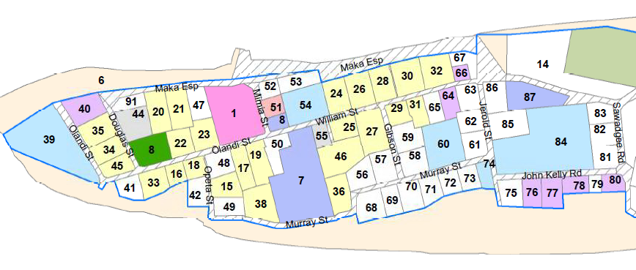
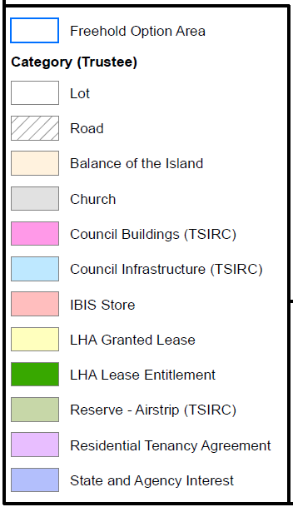
Draft Freehold Schedule (map)

Slide 12
Draft Freehold Schedule: discussion
The lots included in the Draft Freehold Schedule are all those marked as “LHA Granted Lease”, “LHA Lease Entitlement” and “Residential Tenancy Agreement”.
Council has not set a maximum block size.
Council has not set a limit on how many blocks a person can apply for at one time (but the applicant must be an “interest holder”).
Are there any areas that should not be made available for freehold?

Slide 13
Draft Freehold Policy: Eligibility
(Who could get freehold?)
Default eligibility criteria:
The grant of freehold is limited to the following categories of people:
an Aboriginal person or Torres Strait Islander
the spouse of an Aboriginal person or Torres Strait Islander
a former spouse of an Aboriginal person or Torres Strait Islander
a widow or widower of an Aboriginal person or Torres Strait Islander
Applicant must also be an “interest holder”.

Slide 14
Discussion: Eligibility
(Who could get freehold?)
Council has not set any additional eligibility criteria.
If freehold is made available, should there be any additional eligibility criteria to apply for freehold? (e.g. traditional owner?)
Should there be restricted eligibility criteria for particular areas of land?

Slide 15
Discussion
Providing freehold in Torres Strait Islander communities aims to provide opportunities for social and economic development.
What would be the social and financial effects in providing the option of private freehold at Poruma? (good and bad)
What are the potential opportunities available to attract investment into Poruma community by providing ordinary freehold?

Slide 16
Recap: Pros of freehold
Pros
Native Title and Trustee approval not required for future development or leasing (planning approval may be required).
Legal certainty of land ownership.
Can be used as a tool to ‘cement’ traditional boundaries via formal Survey.
Exclusive control of your own land (as long as you comply with the law).
Potential for economic independence (leasing and mortgaging land available).
Land/house becomes an asset with a market value on the property market.
Ability to transfer freehold title to loved ones under a Will.
Ability to hold land with others as co-owners, and decide who will own the land when the registered owner dies.
This is not an exclusive list of Pros and Cons and should not be relied upon by potential applicants when deciding whether or not to support/ apply for a freehold grant. Applicants should always seek independent legal and financial advice.

Slide 17
Recap: Cons of freehold
Cons
Up-front purchase cost
Ongoing costs of home ownership
Owner is legally responsible for use of the land (and misuse)
Traditional rights no longer legally recognised over the land
Could weaken Traditional Law and Ailan Kastom in the community
Potential sale to non-community members (loss of traditional land)
Risk of losing traditional land if unable to afford ongoing costs of home ownership (mortgagee sale)
Could make land management in Torres Strait more complicated by adding another type of land holding.
This is not an exclusive list of Pros and Cons and should not be relied upon by potential applicants when deciding whether or not to support/ apply for a freehold grant. Applicants should always seek independent legal and financial advice.

Slide 18
Cost to obtain freehold: summary
Application fee
House price (State methodology)
Land price (cost recovery)
Compensation
Cost of survey (if land not yet surveyed)
Registration fees (Land Titles Office)
Legal costs

Slide 19
Draft Freehold Policy: Application fee
The Trustee will set an application fee, to cover administration costs.

Slide 20
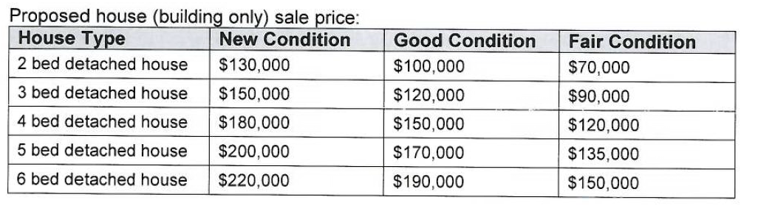
Draft Freehold Policy: House Price
For social houses: Council and the Department of Housing must agree to sell the house to the freehold applicant.
(The same prices are proposed for 99-year home ownership leases.)
House condition assessments are currently being conducted in TSIRC communities.

Slide 21
Draft Freehold Policy: Land Price
Land price is set by the Trustee.
Proposed price structure:
  $4,000 for 2,000 square metres plus $100 for each additional 100 square metres.

Slide 22
Draft Freehold Policy: Compensation
Where native title exists, an ILUA (agreement with the PBC) is required.
The applicant for freehold may have to pay compensation to the PBC because the TO of that land will lose native title forever.
  Example 1: NIL compensation/freehold title as compensation (where applicant is the Traditional Owner of the land)
  Example 2: could be calculated based on estimated valuation (land value) + additional special value for native title extinguishment

Slide 23
Draft Freehold Policy: Other conditions
The land must be surveyed, must have dedicated road access and must have access to essential services (water, waste and power).
The applicant would be responsible for the cost of satisfying all conditions.

Slide 24
What happens next?
The draft Freehold Instrument is available to the community for comment.
Council will consider all feedback and decide whether to make freehold available at Poruma.
If Council decides to make freehold available, Council will submit the Freehold Instrument to the Minister.
If Freehold is made available, Council (as Trustee) will invite “interest holders” to apply for freehold title.
For applications approved by the Trustee, the State will grant the freehold.
The process must address native title.

Slide 25
Freehold is optional
Ordinary freehold does not have to be introduced to Poruma. It could happen now, later or never.
Council will decide based on the community’s feedback.
Let us know what you think of the freehold option today or later.
Written comments are welcome: please email freehold@tsirc.qld.gov.au or drop off a letter at the Council office. Every submission will be considered.

Slide 26

Questions and discussion
Should private freehold land ownership be made available at Poruma?

